Slide 1

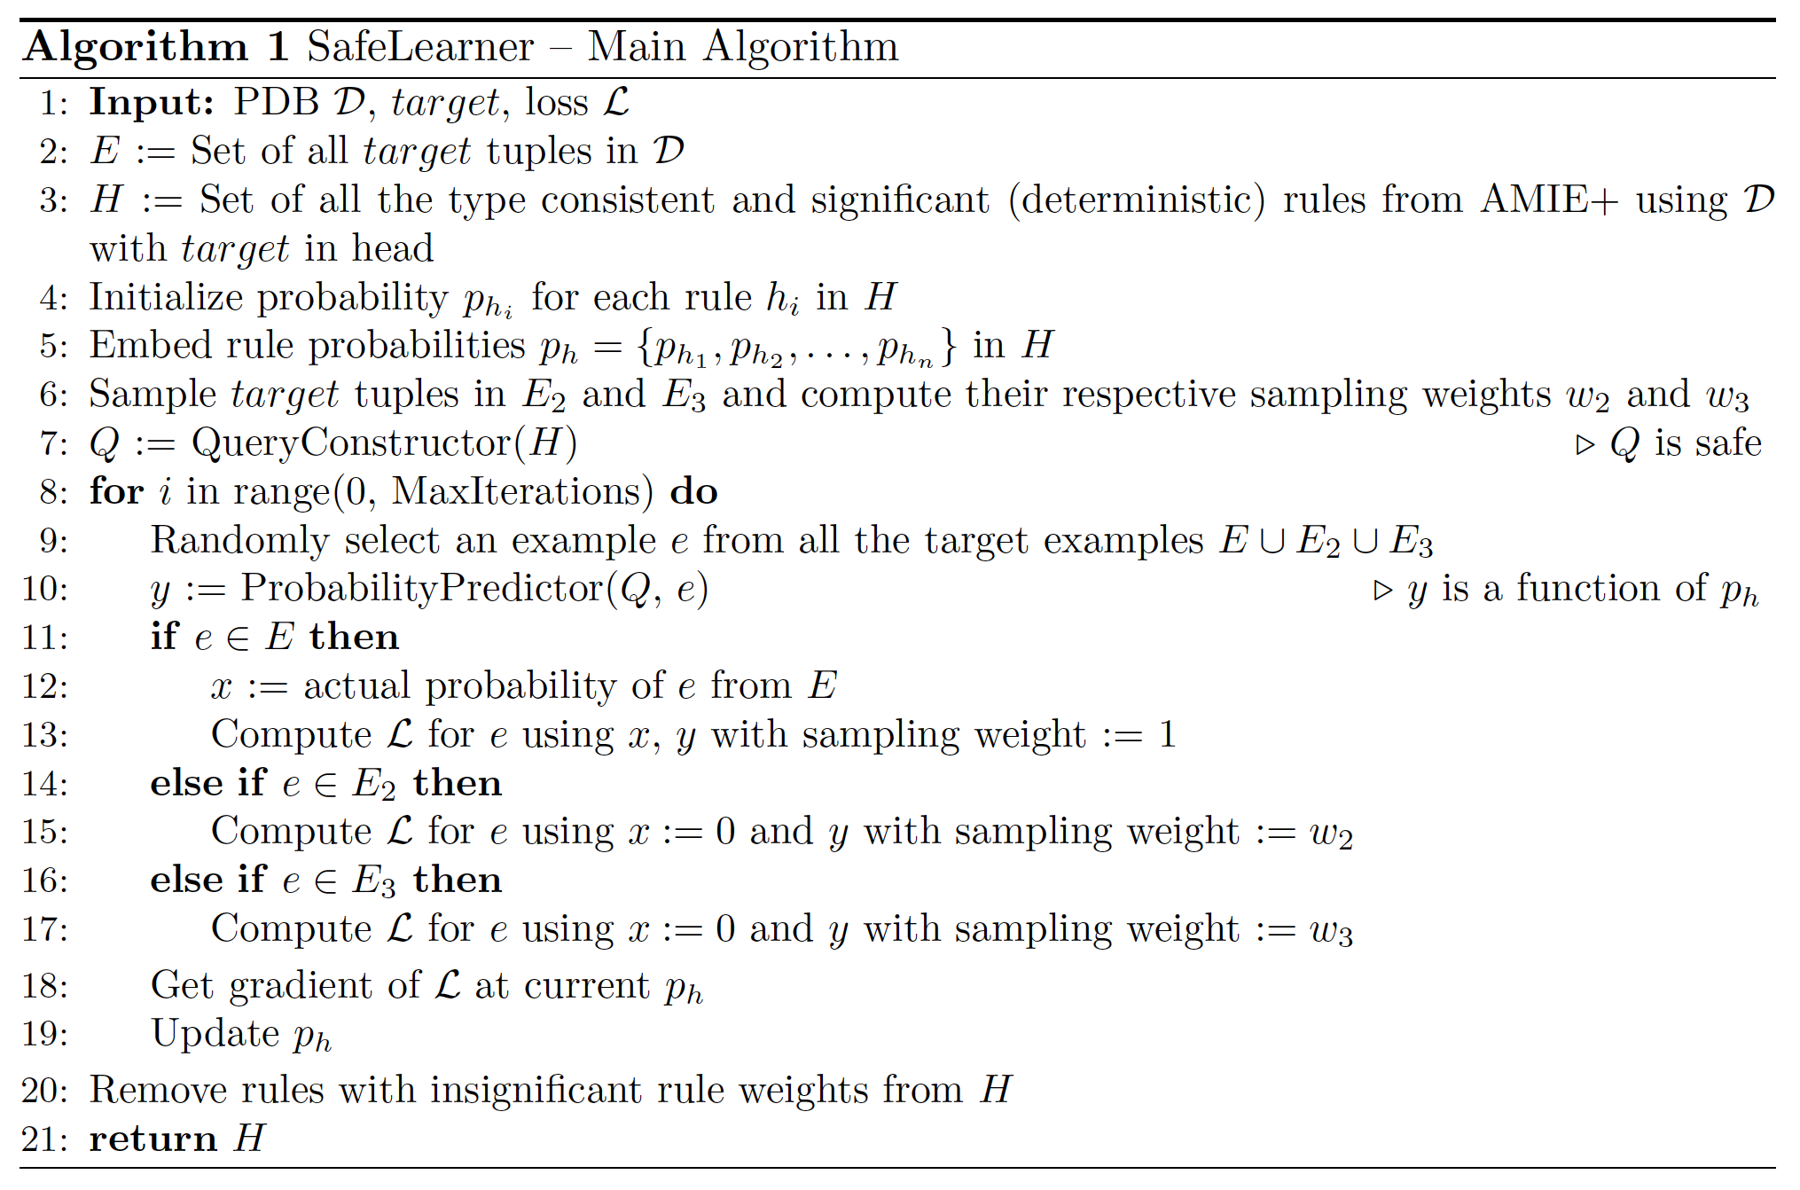

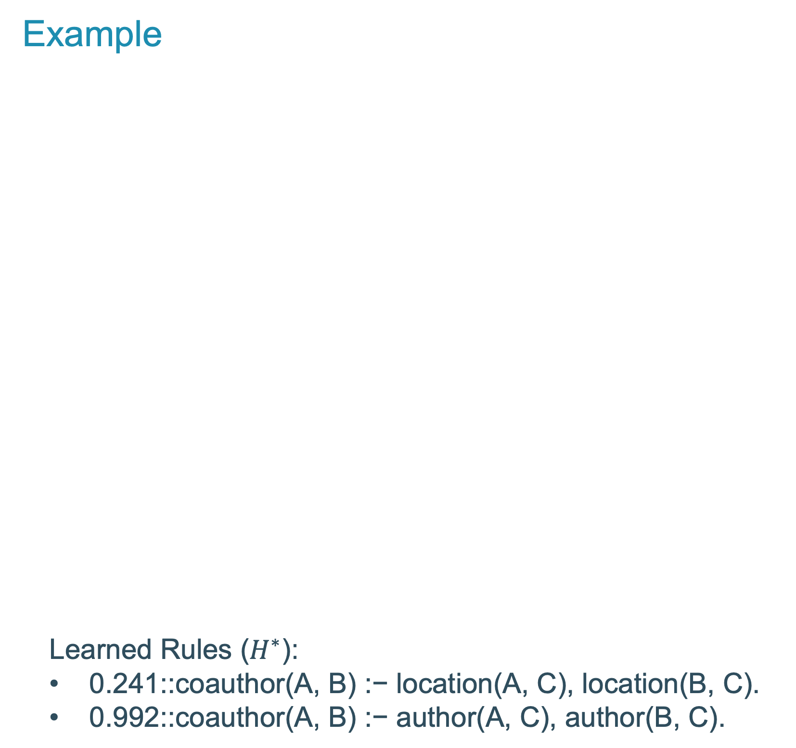
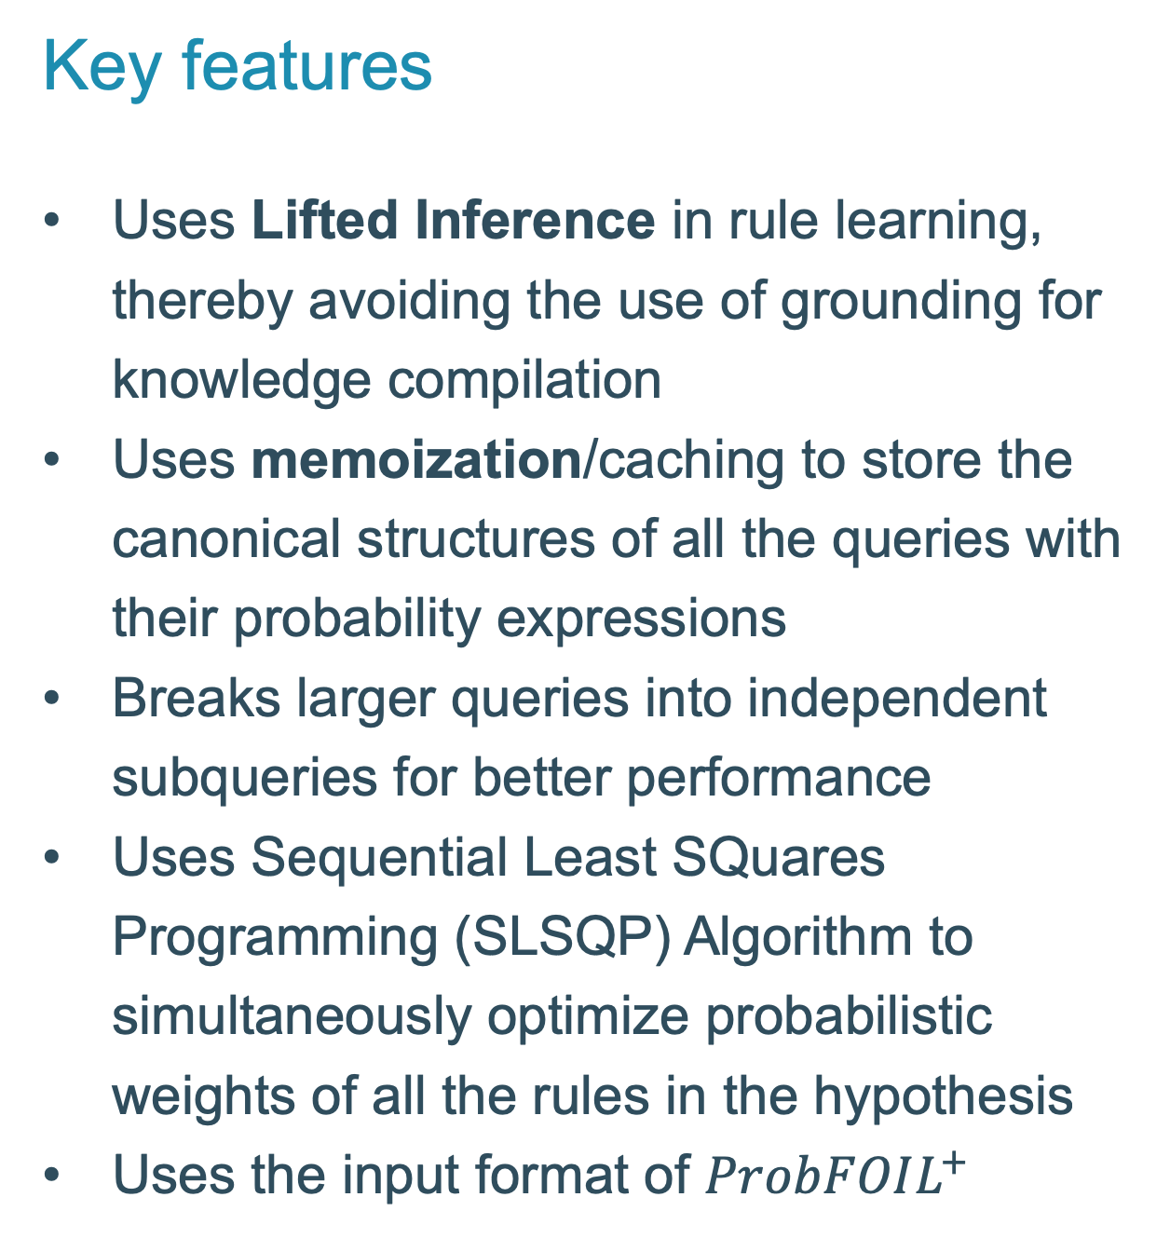
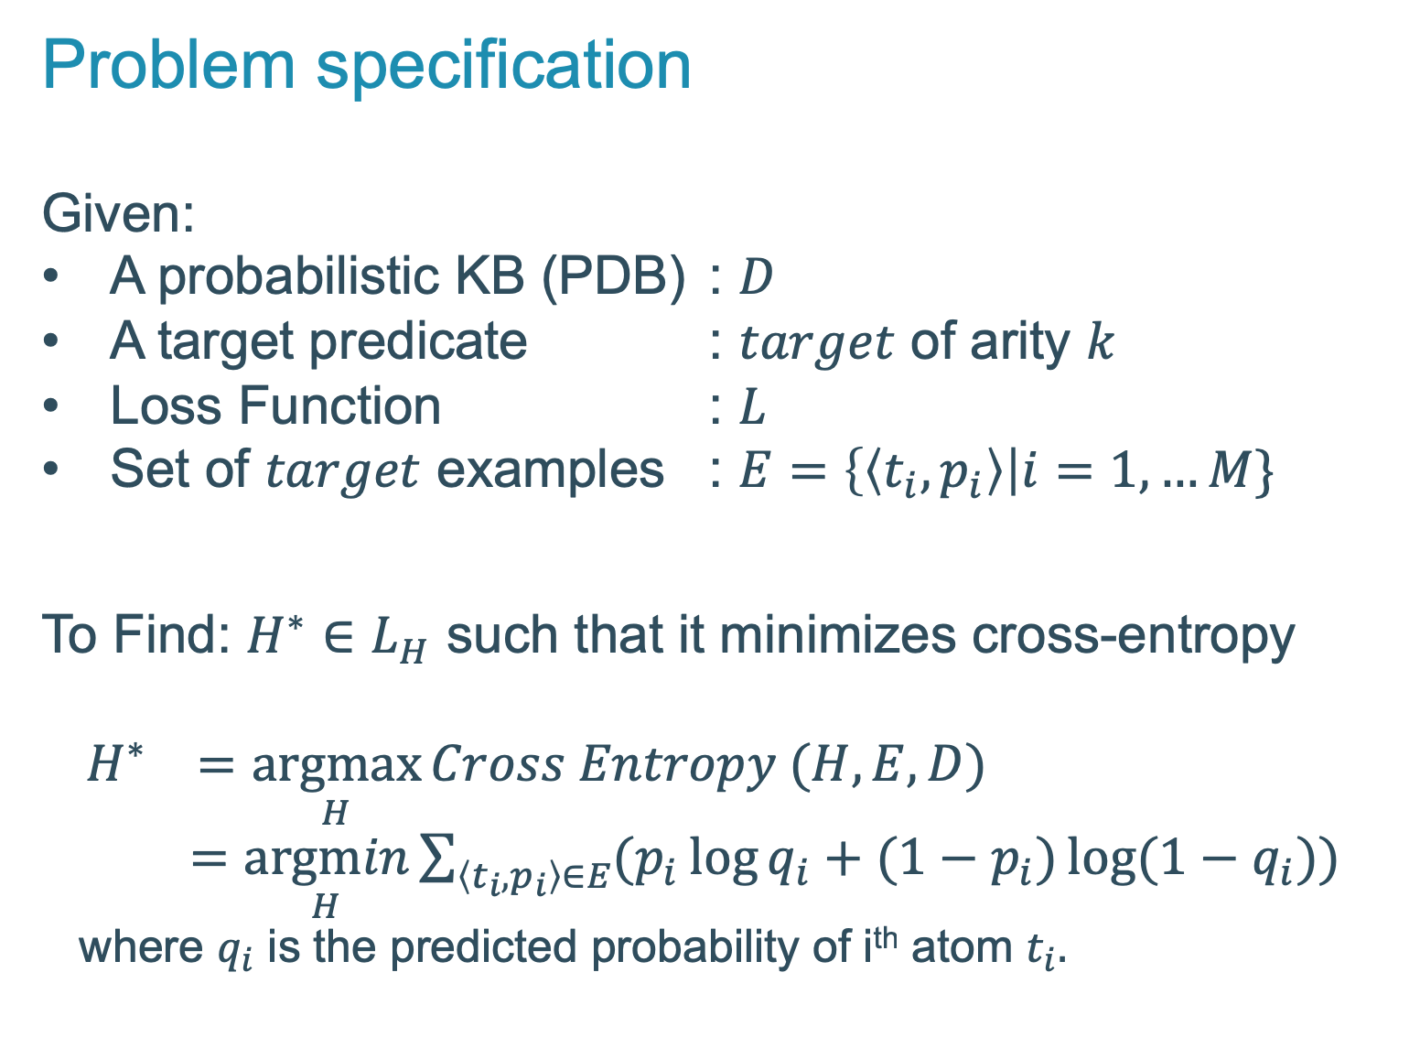
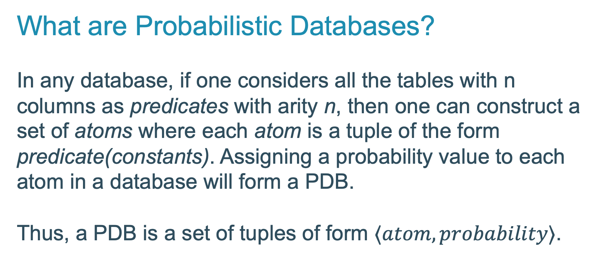
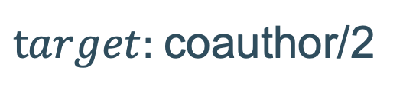
Scalable Rule Learning in Probabilistic Knowledge Bases
SafeLearner
Knowledge Bases (KBs) are becoming increasingly:
What is new?
To do completion of uncertain knowledge bases, we use Lifted Probabilistic Inference
Why SafeLearner?
Significantly faster than ProbFOIL⁺
Scales as good as AMIE+
How much/fast does it scale?
SafeLearner has demonstrated the learning of rules on a KB with 14k+ tuples under 2.5 hours
What are Probabilistic Databases?
In any database, if one considers all the tables with n columns as predicates with arity n, then one can construct a set of atoms where each atom is a tuple of the form predicate(constants). Assigning a probability value to each atom in a database will form a PDB. Thus, a PDB is a set of tuples of form $⟨atom, probability⟩$.
Larger | Probabilistic | Incomplete
Example
Learned Rules ($H^{∗}$):
$\text{0.241::}\text{coauthor}\text{(}\text{A}\text{, }\text{B}\text{) :}\text{− }\text{location}\text{(}\text{A}\text{, }\text{C}\text{), }\text{location}\text{(}\text{B}\text{, }\text{C}\text{).}$
$\text{0.992::}\text{coauthor}\text{(}\text{A}\text{, }\text{B}\text{) :}\text{− }\text{author}\text{(}\text{A}\text{, }\text{C}\text{), }\text{author}\text{(}\text{B}\text{, }\text{C}\text{).}$
researcher | researcher | p
alice | edwin | 0.2
alice | fred | 0.3
bob | carl | 0.4
bob | greg | 0.5
bob | harry | 0.6
bob | ian | 0.7
carl | greg | 0.8
carl | harry | 0.9
carl | ian | 0.8
dave | edwin | 0.7
dave | fred | 0.6
edwin | fred | 0.5
greg | harry | 0.4
greg | ian | 0.3
ian | ian | 0.2
researcher | paper | p
bob | plp | 0.9
carl | plp | 0.6
greg | plp | 0.7
ian | db | 0.9
harry | db | 0.8
Problem specification
Given:
A probabilistic KB (PDB) : $D$
A target predicate : $target$ of arity $k$
Loss Function : $L$
Set of $target$ examples : $E=\left\{\left\langle t_{i}, p_{i}\right\rangle \right|i=1, …M\}$
To Find: $H^{∗}∈L_{H}$ such that it minimizes cross-entropy
$H^{∗} =\underset{H}{argmax}{Cross Entropy (H, E, D)}$
$=\underset{H}{argmin}\sum_{\left\langle t_{i}, p_{i}\right\rangle ∈E}{(p_{i}\log{q_{i}}+(1−p_{i})\log{(1−q_{i})})}$
where $q_{i}$ is the predicted probability of i^{th} atom $t_{i}.$
author/2
researcher | university | p
edwin | harvard | 1.0
fred | harvard | 0.9
alice | mit | 0.6
dave | mit | 0.7
$target:$coauthor/2
location/2
Key features
Uses Lifted Inference in rule learning, thereby avoiding the use of grounding for knowledge compilation
Uses memoization/caching to store the canonical structures of all the queries with their probability expressions
Breaks larger queries into independent subqueries for better performance
Uses Sequential Least SQuares Programming (SLSQP) Algorithm to simultaneously optimize probabilistic weights of all the rules in the hypothesis
Uses the input format of $ProbFOIL^{+}$
Reference: https://openreview.net/pdf?id=HkyI-5667, 1st conference on Automated KB Construction 2019
Arcchit Jain | Tal Friedman | Ondřej Kuželka | Guy Van den Broeck | Luc De Raedt
KU Leuven | University of California Los Angeles | KU Leuven | University of California Los Angeles | KU Leuven

